Slide 1
Post-Quantum Cryptography for Engineers
draft-ar-pquip-pqc-engineers-02 - Post-Quantum Cryptography for Engineers (ietf.org)
PQUIP IETF 117
25th July 2023
Authors: Aritra Banerjee (Nokia), K Tirumaleswar Reddy (Nokia), Dimitrios Schoinianakis (Nokia), Tim Hollebeek (DigiCert)

Slide 2
Why the draft is relevant to PQUIP?
The draft explains why engineers need to be aware of and understand post-quantum cryptography.
It emphasizes the potential impact of Cryptographically Relevant Quantum Computers (CRQCs) on current cryptographic systems and the need to transition to post-quantum algorithms to ensure long-term security.
Not much cryptographic math is used in explained in this draft but rather an overview of post quantum use in protocols.

Slide 3
Contents of the draft
Traditional Cryptographic Primitives that Could Be Replaced by PQC
NIST PQC Algorithms
Threat of CRQCs on Cryptography
Timeline for transition (Mosca’s model)
Post-quantum cryptography categories
KEMs, Signatures
Recommendations for Security / Performance Trade-offs (PQC vs Classical)
Post-Quantum and Traditional Hybrid Schemes
Security Considerations

Slide 4








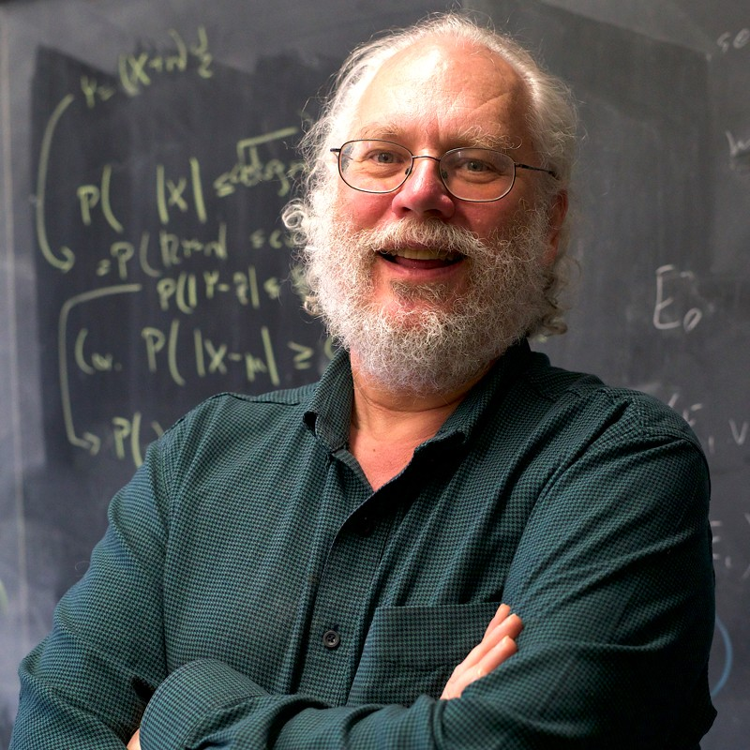
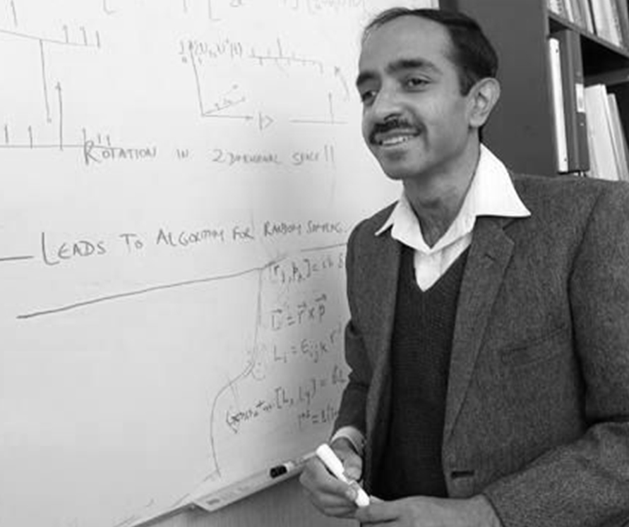
Impact of Quantum Computers in Cryptography
Asymmetric Crypto
Symmetric Crypto
Double key sizes (theoretically)
Broken
Peter Shor Algorithm for prime factorization of large integers
Lov Kumar Grover shows how to search in √𝑁

Slide 5
Asymmetric Cryptography (Shor’s Algorithm)
Shor's algorithm helps find the order of an element of a periodic group thus effectively solving the order finding problem
This has potential applications in breaking algorithms based on the hardness of prime factoring and the discrete log problem.
Potential affected algorithms include RSA, ECC, ECDH, etc.

Slide 6
Symmetric Cryptography (Grover’s algorithm)
Grover’s algorithm theoretically requires us to double the key-size (AES128 -> AES256)​
This would affect all symmetric crypto algorithms that are used currently.
Yet, this is a misconception:​
Grover’s algorithm is highly non parallelizable​
Even thousands of QCs running in parallel would offer minimal gains in breaking symmetric keys.
NIST still standardizes AES-128 (link).

Slide 7


A Harvest Now and Decrypt Later (HNDL) Attack on TLS
TLS Session
Handshake
Data Exchange
Quantum attack using Shor
Key Establishment
Obtain private key
Ciphertext
Decrypt using extracted key
Plaintext

Slide 8
Traditional Cryptographic Primitives that Could Be Replaced by PQC
Asymmetric cryptographic algorithms based on integer factorization, finite field discrete logarithms or elliptic curve discrete logarithms will be vulnerable to attacks using Shor's Algorithm on a CRQC
Key Agreement
Digital Signatures

Slide 9
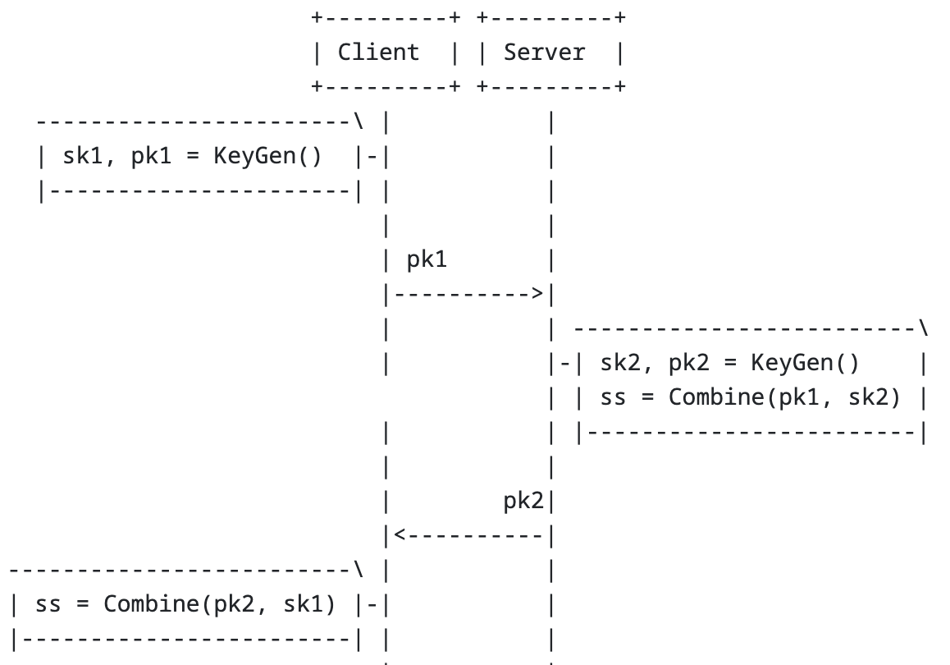
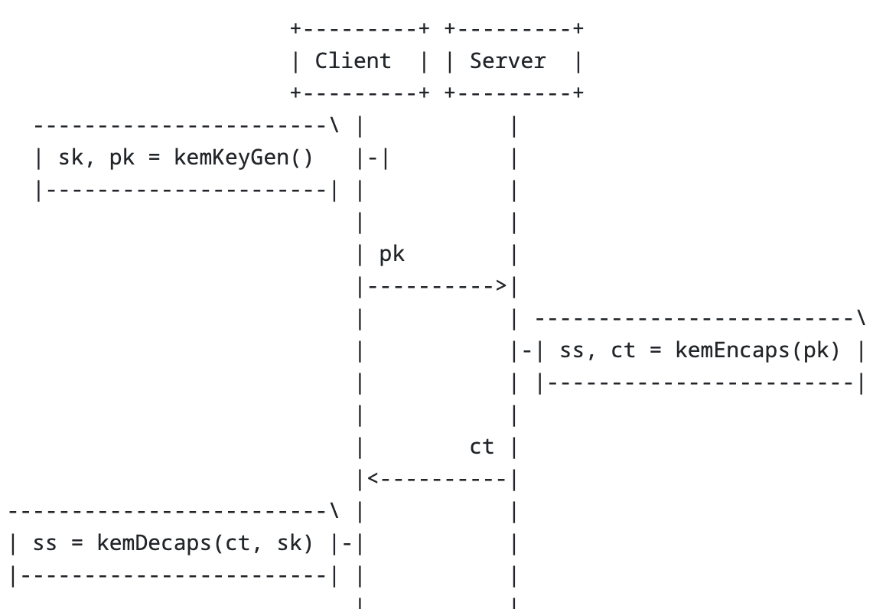
KEM
DH KEX

Slide 10
HPKE
HPKE (Hybrid public key encryption) {RFC9180} deals with a variant of KEM which is essentially a PKE of arbitrary sized plaintexts for a recipient public key.
It works with a combination of KEMs, KDFs and AEAD schemes (Authenticated Encryption with Additional Data).
HPKE includes three authenticated variants, including one that authenticates possession of a pre-shared key and two optional ones that authenticate possession of a key encapsulation mechanism (KEM) private key.

Slide 11
Note on Kyber
Kyber, which is a KEM does not support the static-ephemeral key exchange that allows HPKE based on DH based KEMs its (optional) authenticated modes as discussed in Section 1.2 of {{?I-D.westerbaan-cfrg-hpke-xyber768d00-02}}.

Slide 12
NIST Candidates Selected for Standardization/4th Round Candidates
Code-Based Cryptography
Lattice Based Cryptography
 | Finalists | 4th round
KEM/Encryption | CRYSTALS-KYBER | BIKE Classic McEliece HQC SIKE
Signatures | CRYSTALS-Dilithium FALCON SPHINCS⁺
Isogeny based Cryptography : Broken!
Hash Based Signatures

Slide 13
Security property for KEM and Signatures
IND-CCA2
EUF-CMA
IND-CCA2 (Indistinguishability under adaptive Chosen-Ciphertext Attack) is an advanced security notion for encryption schemes. It ensures the confidentiality of the plaintext, resistance against chosen-ciphertext attacks, and prevents the adversary from forging new ciphertexts.
Kyber, BIKE, Classic McEliece provide IND-CCA2 security
EUF-CMA (Existential Unforgeability under Chosen Message Attack) [GMR88] is a security notion for digital signature schemes. It guarantees that an adversary, even with access to a signing oracle, cannot forge a valid signature for an arbitrary message. EUF-CMA provides strong protection against forgery attacks, ensuring the integrity and authenticity of digital signatures by preventing unauthorized modifications or fraudulent signatures.
Dilithium, Falcon and Sphincs+ provide EUF-CMA security.

Slide 14


PQC standardization timeline
Announcement 4 finalists (1 ΚΕΜ, 3 Digital signatures
Announcement 4th round starts
Deadline for additional Digital Signature Schemes (June 1, 2023)
1st NIST workshop on PQC
Announcement 26 algorithms make it to 2nd round
Submission deadline 82 received, 69 accepted
NIST announces competition-like process
Announcement 7 finalists and 8 alternate algorithms for the 3rd round
Final standard
2015
2016
2017
2020
2022
2023
2024

Slide 15
Mosca's theorem of cybersecurity in the quantum era¹
What do we do here?
y
x
z
Secrets revealed
time
If x + y > z, then start worrying
x: time we want to keep our systems secure
y: time to deploy a quantum-safe migration plan
z: time to build a large-scale quantum computer (2030s?)
[1] https://eprint.iacr.org/2015/1075.pdf

Slide 16
Details of XMSS and LMS
PQC: XMSS (RFC8391) and LMS (RFC8554) are stateful hash-based signature schemes.
Reusing a secret key state compromises cryptographic security guarantees.
Signing a potentially large but fixed number of messages
The number of signing operations depends upon the size of the tree.
Increasing the number of layers reduces key generation time exponentially and signing time linearly at the cost of increasing the signature size linearly.

Slide 17
Hash-then-Sign vs Sign-then-Hash
Hash-then-Sign: Fixed size digest of the message is signed.
Rely on the collision-resistance of the hash function.
Reduces the size of signed messages.
Protocols like TLS 1.3 and DNSSEC use the Hash-then-Sign paradigm.
PQC Signature schemes internally apply hash functions.

Slide 18
Security levels (PQC Algorithms: NIST)
PQ Security Level | AES/SHA3 hardness | PQC Algorithm
1 | Find optimal key in AES-128 | Kyber512, Falcon512, Sphincs+SHA256 128f/s
2 | Find optimal collision in SHA3-256 | Dilithium2
3 | Find optimal key in AES-192 | Kyber768, Dilithium3, Sphincs+SHA256 192f/s
4 | Find optimal collision in SHA3-384 | No algorithm tested at this level
5 | Find optimal key in AES-256 | Kyber1024, Falcon1024, Dilithium5, Sphincs+SHA256 256f/s

Slide 19
Key & ciphertext/signatures of PQC Algorithms on different security levels
PQ Security Level | Algorithm | Public key size (in bytes) | Private key size (in bytes) | Ciphertext/Signature size (in bytes)
1 | Kyber512 | 800 | 1632 | 768
1 | Falcon512 | 897 | 1281 | 666
2 | Dilithium2 | 1312 | 2528 | 2420
3 | Kyber768 | 1184 | 2400 | 1088
5 | Falcon1024 | 1793 | 2305 | 1280
5 | Kyber1024 | 1568 | 3168 | 1588

Slide 20
SPHINCS+ and its many variants (Simple only)
PQ Security Level | Algorithm | Public key size (in bytes) | Private key size (in bytes) | Signature size (in bytes)
1 | SPHINCS+-{SHA2,SHAKE}-128f | 32 | 64 | 17088
1 | SPHINCS+-{SHA2,SHAKE}-128s | 32 | 64 | 7856
3 | SPHINCS+-{SHA2,SHAKE}-192f | 48 | 96 | 35664
3 | SPHINCS+-{SHA2,SHAKE}-192s | 48 | 96 | 16224
5 | SPHINCS+-{SHA2,SHAKE}-256f | 64 | 128 | 49856
5 | SPHINCS+-{SHA2,SHAKE}-256s | 64 | 128 | 29792
SPHINCS+ algorithm security levels for different categories i.e., (f) for fast verification and (s) for compactness/smaller. Both SHA256 and SHAKE-256 parametrisation output the same signature sizes, so both have been included.

Slide 21
Falcon vs Dilithium vs Sphincs+
Dilithium is known for its relatively fast signature generation, while Falcon can provide more efficient signature verification.
Falcon also has lower key and signature sizes as compared to Dilithium.
SPHINCS+ offers smaller key sizes, larger signature sizes, slower signature generation, and slower verification when compared to Dilithium and Falcon.

Slide 22
Challenges in Falcon's Signing Operations
Falcon's signing operations require constant-time, 64-bit floating point operations to avoid catastrophic side channel vulnerabilities. Doing this correctly (which is also platform-dependent to an extreme degree) is very difficult, as NIST's report noted.
Providing a masked implementation of Falcon also seems impossible, per the authors at the RWPQC 2023 symposium earlier this year.

Slide 23
PQC vs Traditional KEMs/KEXs
PQ Security Level | Algorithm | Public key size (in bytes) | Private key size (in bytes) | Ciphertext size (in bytes)
Traditional | P256_HKDF_SHA256 | 65 | 32 | 65
Traditional | P521_HKDF_SHA512 | 133 | 66 | 133
Traditional | X25519_HKDF_SHA256 | 32 | 32 | 32
1 | Kyber512 | 800 | 1632 | 768
3 | Kyber768 | 1184 | 2400 | 1088
5 | Kyber1024 | 1568 | 3168 | 1588

Slide 24
PQC vs Traditional Signatures
PQ Security Level | Algorithm | Public key size (in bytes) | Private key size (in bytes) | Signature size (in bytes)
Traditional | RSA2048 | 256 | 256 | 256
Traditional | P256 | 64 | 32 | 64
1 | Falcon512 | 897 | 1281 | 666
2 | Dilithium2 | 1312 | 2528 | 768
3 | Dilithium3 | 1952 | 4000 | 3293
5 | Falcon1024 | 1793 | 2305 | 1280

Slide 25
PQ/T Hybrid Confidentiality
Protect from protect from "Harvest Now, Decrypt Later" attack
Concatenate hybrid key agreement scheme
Hybrid key exchange in TLS 1.3 https://datatracker.ietf.org/doc/draft-ietf-tls-hybrid-design/
It provides hybrid confidentiality but does not address hybrid authentication
the client's key-share contains two component public keys, one for a post-quantum algorithm and one for a traditional algorithm (ECDH ephemeral key-share)
For the server’s share, concatenation of ct (ciphertext) and ephemeral key-share (ECDH)
hybrid secret by concatenating the two shared secrets
Cascade hybrid key agreement scheme
Multiple Key Exchanges in the Internet Key Exchange Protocol Version 2 (IKEv2) https://datatracker.ietf.org/doc/rfc9370/
Allows the negotiation of one or more PQC algorithms to exchange data, in addition to the existing (EC)DH key exchange data.

Slide 26
PQ/T Hybrid Authentication
Protect from on-path attacker using CRQC
Authentication through a PQ/T hybrid scheme or a PQ/T hybrid protocol, as long as at least one component algorithm remains secure to provide the intended security level.
The frequency and duration of system upgrades and the time when CRQCs will become widely available need to be weighed in to determine whether and when to support the PQ/T Hybrid Authentication property.
Discussions in LAMPS WG to use PQ/T Hybrid Certificate

Slide 27
Hybrid Mechanisms
It is possible to use more than two algorithms together in a hybrid scheme, and there are multiple possible ways those algorithms can be combined.
For the purposes of a post-quantum transition, the simple combination of a post-quantum algorithm with a single classical algorithm is the most straightforward, but the use of multiple post-quantum algorithms with different hard math problems has also been considered.
When combining algorithms, it is possible to require that both algorithms validate (the so-called "and" mode) or that only one does (the "or" mode), or even some more complicated scheme.
Schemes that do not require both algorithms to validate only have the strength of the weakest algorithm, and therefore offer little or no security benefit.

Slide 28
Hybrid Mechanisms (Cont.)
When combining keys in an "and" mode, it may make more sense to consider them to be a single composite key, instead of two keys.
This generally requires fewer changes to various components of PKI ecosystems, many of which are not prepared to deal with two keys or dual signatures.
To an implementer, a "composite" algorithm composed of two other algorithms is simply a new algorithm, and support for adding new algorithms generally already exists.

Slide 29
Hybrid Mechanisms (Cont.)
All that needs to be done is to standardize the formats of how the two keys from the two algorithms are combined into a single data structure, and how the two resulting signatures are combined into a single signature.
The answer can be as simple as concatenation, if the lengths are fixed or easily determined.
Many of these points are still being actively explored and discussed, and the consensus may change over time

Slide 30
Security Considerations - Cryptanalysis
Classical cryptanalysis exploits weaknesses in algorithm design, mathematical vulnerabilities, or implementation flaws, whereas quantum cryptanalysis harnesses the power of CRQCs to solve specific mathematical problems more efficiently.
Both pose threats to the security of cryptographic algorithms, including those used in PQC
Developing and adopting new cryptographic algorithms resilient against these threats is crucial for ensuring long-term security in the face of advancing cryptanalysis techniques

Slide 31
Security Considerations - Cryptographic Agility
Cryptographic agility is relevant for both classical and quantum cryptanalysis as it enables organizations to adapt to emerging threats, adopt stronger algorithms, comply with standards, and plan for long-term security in the face of evolving cryptanalytic techniques and the advent of CRQCs.
Several PQC schemes are available that need to be tested; cryptography experts around the world are pushing for the best possible solutions, and the first standards that will ease the introduction of PQC are being prepared

Slide 32
Hybrid Key Exchange : Bridging the Gap Between Post-Quantum and Traditional Cryptography
Post-quantum algorithms selected for standardization are relatively new and they they have not been subject to the same depth of study as traditional algorithms.
In addition, certain deployments may need to retain traditional algorithms due to regulatory constraints, for example FIPS compliance.
Hybrid key exchange enables potential security against "Harvest Now, Decrypt Later" attack while not fully abandoning traditional cryptosystems.

Slide 33
Contributing to this document
Comments and Suggestions are welcome
The document is being collaborated on: tireddy2/pqc-for-engineers (github.com)
E-mail archive: pqc (ietf.org)

